Slide 1


Capstone Project
TELECOM
By: Debananda Mishra
Bootcamp 10
Jigsaw Academy, Bangalore

Slide 2
What are the top five factors driving likelihood of churn at “Mobicom”?
The top 5 factors driving likelihood of churn can be obtained by sorting the coefficients of the final model (mod_final) in order of probability value
This can be done using the code
modcoef<- summary(mod_final)[[“coefficients”]]
head(modcoef[order(modcoef[,4]),])

Slide 3
The factors obtained which affect the likelihood of churn at Mobicom are :
Variables | Beta coefficient | Probability Pr(>|z|)
eqpdays | 1.322194e-03 | 2.034658e-117
retdays.1 | 7.832697e-01 | 3.690229e-51
months | -2.216305e-02 | 8.512286e-38
complete_Mean | -2.957511e-03 | 4.709827e-33
call_per_min3 | 9.281897e-01 | 2.731677e-24

Slide 4
Validation of survey findings. a) Whether “cost and billing” and “network and service quality” are important factors influencing churn behavior. b) Are data usage connectivity issues turning out to be costly? In other words, is it leading to churn?

Slide 5
A) <i> The factors affecting “cost and billing” are:
variable totmrc_Mean has beta coefficient value of -0.005983219 meaning a unit increase in this variable is causing decrease in churn by 0.005983219 per unit.
variable avgrev has beta coefficient value of 0.002507759 meaning a unit increase in this variable is causing increase in churn by 0.002507759 per unit
We notice from the above mentioned beta values, a unit increase in them is having almost 0% impact on churn. So it seems cost and billing is not very important factors here influencing churn behavior at Mobicom.
totmrc_Mean | -0.005983219
Avgrev | 0.002507759

Slide 6
A) <ii> The variables explaining “network and service quality”
Variables | Beta coefficients
mou_Range | 0.0004129735
change_mou | -0.0006244418
drop_blck_Mean | 0.009055601
drop_vce_Range | 0.01442898
mou_opkv_Range | -0.0003691965
iwylis_vce_Mean | -0.01282256
ovrmou_Mean | 0.003932938
complete_mean | -0.002957511
call_per_min3 | 0.9281897
retdays .1 | 0.7832697
months | -0.02216305

Slide 7
Of the above variables, the beta coefficients of variables retdays.1 and months are expressing a very important factors influencing churn behavior.
With the increase in the number of days since a customer makes a retention call, the customer’s chances of churning is very high.
With the increase in the number of months in service, the customer’s chances of churning is very high.
Based on the above factors, special attention should be given to these customers in solving their queries and they should entertain some special offers to customers as well.

Slide 8
B) variables showing data usage are
The data quality report in the “project.R” file shows that only 10-15% customers are actually making data calls or using the internet
So it would be good to work toward attaining more customers to use data and also toward providing quality network connectivity and service to provide maximum customer satisfaction and reduce churn.
Since there is not enough usable data for the above variables they are not showing any influence on churn behavior at Mobicom
Variables | Description
Comp_dat_Mean | Mean no.of completed data calls
Plcd_dat_Mean | Mean no.of attempted data calls placed
Opk_dat_Mean | Mean no.of off-peak data calls
Blck_dat_Mean | Mean no.of blocked/ failed data calls
Datovr_Mean | Mean revenue of data ovrage
Drop_dat_Mean | Mean no.of dropped/ failed data calls

Slide 9
Would you recommend rate plan migration as a proactive retention strategy?
Yes but not for all
Reason: variable ovrmou_Mean has beta coefficient 0.003933; it’s the mean overage minutes of use.
The coefficient is not strong to show churn activity, so we consider for few set of customers who have some case basis validation success.
But rate plan migration as a proactive retention strategy will not work for all

Slide 10
What would be your recommendation on how to use this churn model for prioritization of customers for a proactive retention campaigns in the future?
Gain chart is a popular method to visually inspect model performance in binary prediction. It presents the percentage of captured positive responses as a function of selected percentage of a sample.
This can easily done using package gains.

Slide 11
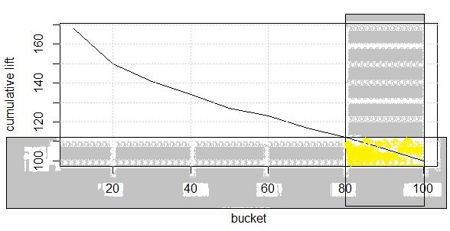
Library(gains)
gains(trsf_df_tst$churn, predict(mod_final, type=“response”, trsf_df_tst), groups=10)
dt<-gains(trsf_df_tst$churn, predict(mod_final, type=“response”, trsf_df_tst), groups=10)
Graphics::plot(dt$depth, dt$cume.lift, type=‘l’, ylab=“cumulative lift”, xlab= “bucket”)
Grid()
####****The top 20% probability shows 30.0.3827% are more likely to churn. ****####

Slide 12

trsf_df_tst$prob<- predict(mod_final, type= “response”,trsf_df_tst)
Quantile(trsf_df_tst$prob, prob= seq(0.10,1.00,0.10))
#### ****Above % shows 20% of the probability contains <from 80% to 100%>- 0.3049566 to 0.8425431****####
####**** This notifies us it may highly likely to churn****####
####**** Predicting a customer who will churn ****####
####**** Applying cutoff ****####
pred2<- predict(mod_final, type=“response”, trsf_df_tst)
pred3<- ifelse(pred2>= 0.3049566,1,0)
Table(pred3, trsf_df_tst$churn)

Slide 13
####**** Take upto <from 80 to 100%> as per quantile result and consider churn value (0 or 1: here 1) then to predict customer use unique to identify via customer id ****####
exp_prediction<- trsf_df_tst[trsf_df_tst$prob>0.3049566 & trsf_df_tst$prob<= 0.8425431 & trsf_df_tst$churn==‘1’, “Customer_ID”]
exp_prediction<- as.data.frame(exp_prediction)
nrow(exp_prediction) ###### 942
CONCLUSION:
This way the model “mod_final” is used to predict list of mobicom customers who are highly likely to churn.
Unique list can be prepared using customer id.

Slide 14
What would be the target segments for proactive retention campaigns? Falling ARPU forecast is also a concern and therefore, Mobicom would like to save their high revenue customers besides managing churn. Given a budget constraint of a contact list of 20% of the subscriber pool, which subscribers should prioritized if “revenue saves” is also a priority besides controlling churn. In other words, controlling churn is the primary objective and revenue saves is the secondary objective.

Slide 15
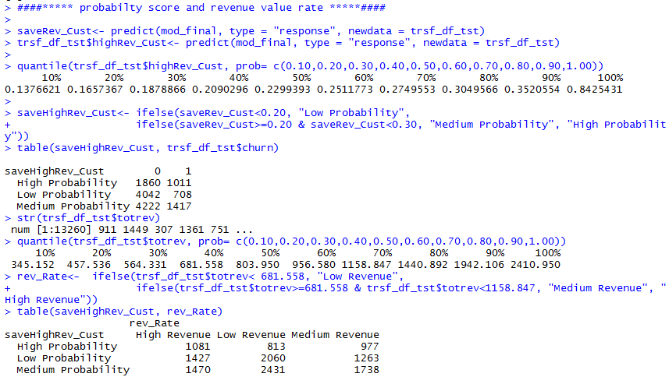

Slide 16
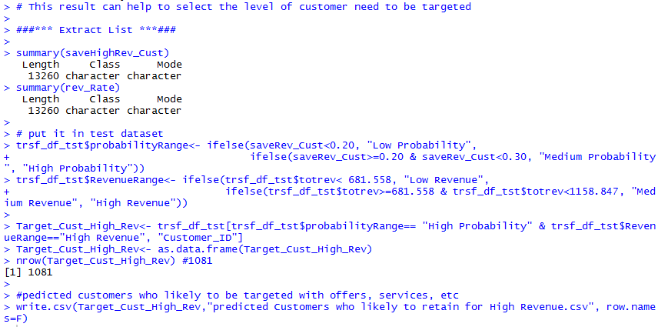

Slide 17
Procedure for model building:
Unique value checking
Changing numeric to factor variable for the variables with less unique values
Outlier treatment: Capping method
Missing value treatment:
Factor variable: created another level of missing values “MISSING”
Numeric variable: imputed with median
Checking correlation:
Removing zero variance variables
Created the correlation matrix
Set a cutoff of 0.7 and removing them
Achieved the desired numeric variable without correlation.

Slide 18
Create test and train data set (here 80% and 20%)
Running the glm with all the character variable and the numeric variables obtained after removing correlation
Removing the insignificant variables one by one and running the model
We check for vif (if aliased coefficient are present remove them)
check for degree of importance of the variables in the model using “VarImp()” function
Create dummies
Pass the definite factor levels which are significant and re-run the model.
Again check for vif and degree of importance
If all vif are less than 5 we got our final model.

Slide 19
Do prediction test and coefficient matrix check and adjust the cutoff such as sensitivity is greater than specificity (as data imbalance).
Determine the best cutoff for maximum accuracy.
Determine the optimal cutoff (maximum sensitivity and specificity)
Choose a good cutoff for the
maximum sensitivity
Minimum specificity
And a considerable accuracy (greater than 50%)
Plot the evaluation curve
Plot the roc (receiver operating characteristic curve)
Check the AUC (area under the curve: 63.31)
solve the business problems (slides 2- 17)

Slide 20
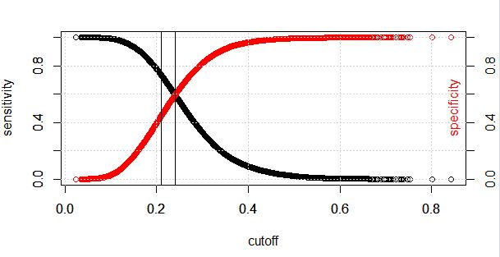
Optimal cutoff plot for maximum sensitivity and specificity:

Slide 21
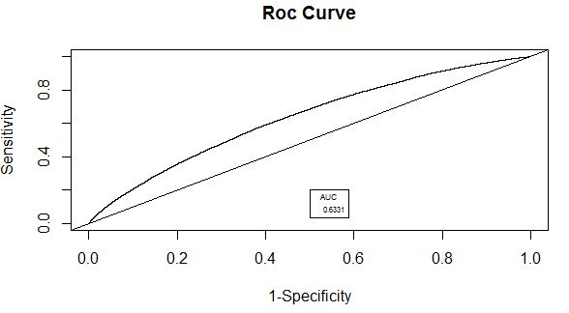
ROC curve and AUC:

Slide 22
References:
www.stackoverflow.com
www.r-bloggers.com
http://r-statistics.co/Outlier-Treatment-With-R.html
http://r-statistics.co/ggplot2-Tutorial-With-R.html
https://stackoverflow.com/questions/51379042/r-data-table-impute-missing-values-for-multiple-set-of-columns

